Slide 1
TANITIM
Rabia GÜL
Notes:
Hi everyone! Welcome to my presentation.
Today, I will be presenting you my final project, which is about investigating the role of innocuous pain stimulation in human machine interface enhancement.
Before I start the presentation, I would like to thank my advisor Elif HOCAOGLU and all of the faculty members who support me in this project.

Slide 2
açılış

Slide 3
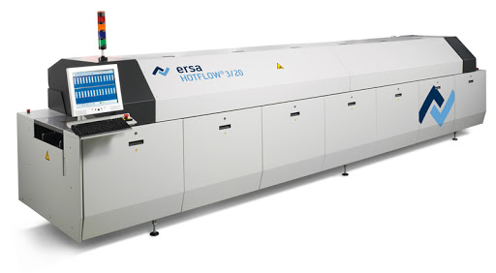
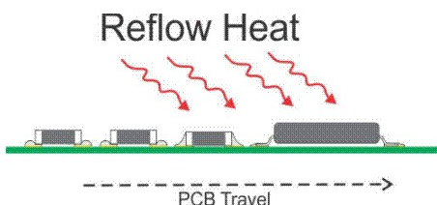
Reflow Oven
The aim of the process is to form solder joints by first pre-heating the components, PCB, solder paste and then melting the solder without causing damage by overheating.
Reflow soldering requires a screen process.
In the screen printing process, a paste containing both solder and flux is administered to the PCB solder pads.
To solder the components to the board, a stream of hot air or radiant heat is applied to the whole board.
This evenly heats up the board, the components, and the solder paste, melting the solder in the paste and connecting the components to the board.

Slide 4
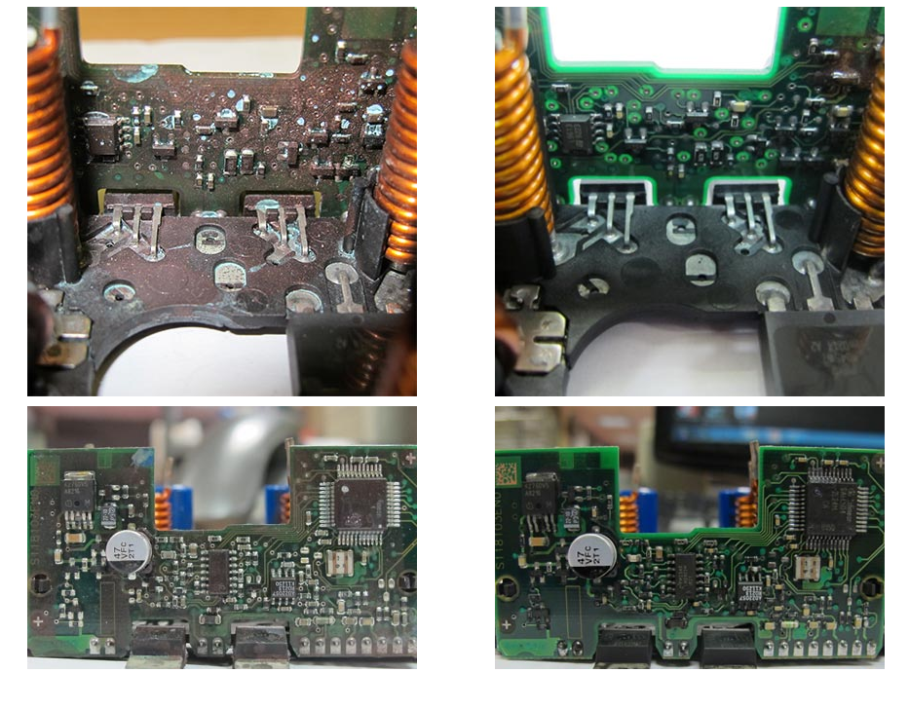
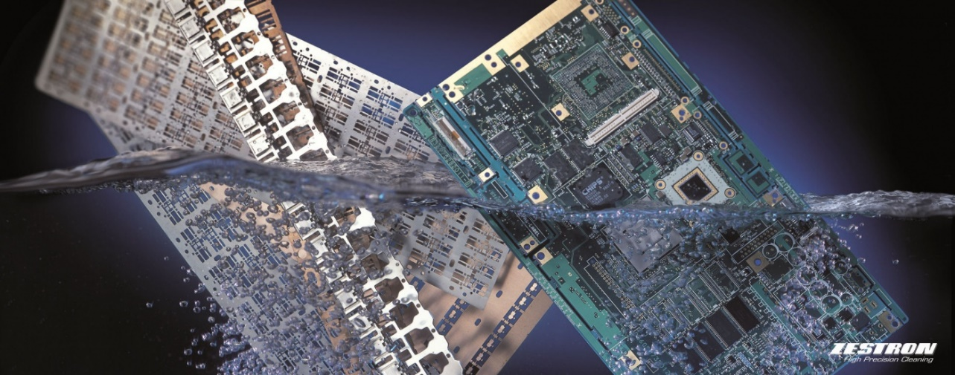
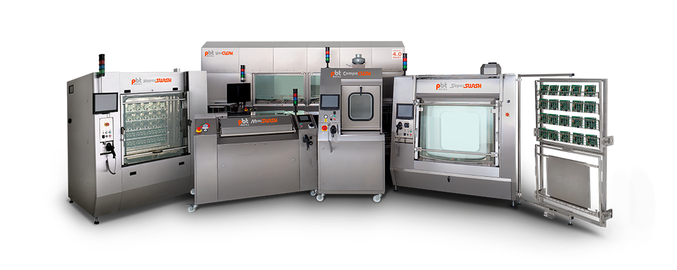
PCB Cleaning
Purpose of the PCB Cleaning
Removing resin and flux residues from filled boards and hybrids
Before circuit board is cleaned
After circuit board is cleaned
Over time, water, dust and dirt can enter your to the devices and accumulate to a point where needed to act to prevent permanent damage to the equipment.
Unwanted material formation causes overheating and component failure.

Slide 5
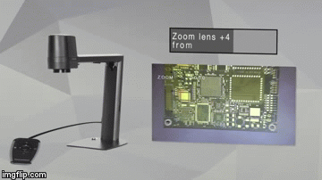
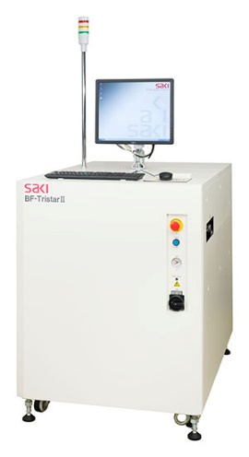
2D/3D Automatic Optic Inspection (AOI)
AOI is an automatic visual inspection of a PCB where a camera is used to scan the board in extremely fine detail to check for any defects or defects.
AOI is a vital inspection system that allows you to measure and monitor the quality of your PCB production and fix any problem or defect at any strategic point in the process flow.
Pattern matching algorithms keep track of both successful and failed PCB assemblies.
Limitations of 3D Systems:
Cannot control 2D elements
Significant cost increase
Significant reduction in speed
Height limitation
Shading issues
No color control
In some cases, implementation, cost factors, and acceptable process parameters may make a 2D machine the better choice, but in other cases the same factors may make a 3D AOI system the better choice.

Slide 6
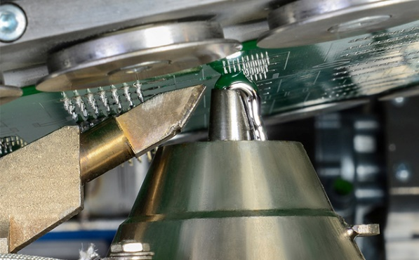
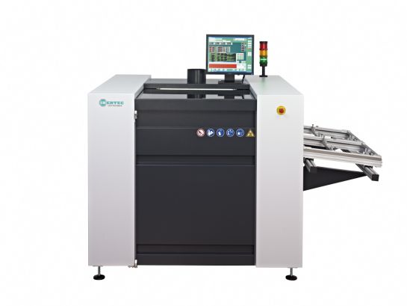
Selective Soldering Machine
Selective soldering is used for soldering printed circuit boards assembled with partially or fully perforated components. Selective soldering consists of three steps;
1) fluxing or liquid flux application,
2) preheating or printed circuit board assembly, and
3) soldering with a site-specific soldering nozzle.
Selective soldering can be successfully used to solder a wide variety of printed circuit board assemblies and has many different advantages, including:
a) Process optimization can be achieved safely and quickly
b) Provides reliable solder connections without overheating components
c) Process repeatability guaranteed
d) Eliminates the use of expensive opening wavy solder pallets or masks
SMT packages are more precise and expensive and must be soldered in a reflow furnace. However, some cards still require punched pins. This poses a minor problem because the hollow pins cannot be soldered in a reflow furnace and must be soldered separately. This can be done by hand or with a selective soldering machine.

Slide 7
Workspace of Pantograph
Environmental Test Chamber
When you know that a given product will be used or installed outdoors and that it needs to withstand the harshest of elements, guessing or hoping for its success simply won't do. You need a solution that can help you determine the item's resilience.
An environmental test chamber is an enclosed space that essentially recreates conditions to determine how a subject will respond to those simulated conditions. These may include extreme heat, sub-zero temperatures, relative humidity, dew point or wet environments in which corrosion tends to thrive.
An environmental chamber, also called a climate chamber, is an enclosure used to test the effects of certain environmental conditions on electronic devices and components.
Environmental test chambers simulate the effect of conditions such as temperature, humidity, air pressure, light, and motion on a product. The environmental chamber can be used to study product performance under a given set of conditions, or to accelerate product lifetime and study the product aging process. An environmental test chamber typically does not include all possible features, but is designed to simulate a specific environment or conditions--such as temperature, humidity, and light; or vibration and soaking.
Features to look for in an environmental chamber include accurate and precise temperature controls, adequate size for your needs, and sufficiently rapid temperature change rates for your conditions.

Slide 8
Jet printer

Slide 9
X-ray pcba analyzer

Slide 10
Flying Probe Test

Slide 11
conformal coating

Slide 12
S parameters

Slide 13
Measurement of the s parameters

Slide 14
Vectork network analyzer

Slide 15
Spectrum analyzer

Slide 16
Network vs. spectrum

Slide 17
Tombstone problem

Slide 18
Vacuum vapor phase soldering

Slide 19
Unit design – pin to pin mapping

Slide 20

Thank You for Listening

Slide 21
References
Mehrholz, J., Hädrich, A., Platz, T., Kugler, J., & Pohl, M. (2012). Electromechanical and robot‐assisted arm training for improving generic activities of daily living, arm function, and arm muscle strength after stroke. Cochrane database of systematic reviews, (6).
Winstein, C. J., Stein, J., Arena, R., Bates, B., Cherney, L. R., Cramer, S. C., ... & Lang, C. E. (2016). Guidelines for adult stroke rehabilitation and recovery: a guideline for healthcare professionals from the American Heart Association/American Stroke Association. Stroke, 47(6), e98-e169.
Dijkers, M. P., deBear, P. C., Erlandson, R. F., Kristy, K., Geer, D. M., & Nichols, A. (1991). Patient and staff acceptance of robotic technology in occupational therapy: a pilot study. J Rehabil Res Dev, 28(2), 33-44.
Frisoli, A., Borelli, L., Montagner, A., Marcheschi, S., Procopio, C., Salsedo, F., ... & Rossi, B. (2007, June). Arm rehabilitation with a robotic exoskeleleton in Virtual Reality. In 2007 IEEE 10th International Conference on Rehabilitation Robotics (pp. 631-642). IEEE.
Hidler, J., & Sainburg, R. (2011). Role of robotics in neurorehabilitation. Topics in spinal cord injury rehabilitation, 17(1), 42-49.
Chen, S. H., Lien, W. M., Wang, W. W., Lee, G. D., Hsu, L. C., Lee, K. W., ... & Luh, J. J. (2016). Assistive control system for upper limb rehabilitation robot. IEEE Transactions on Neural Systems and Rehabilitation Engineering, 24(11), 1199-1209.
Picelli, A., Tamburin, S., Passuello, M., Waldner, A., & Smania, N. (2014). Robot-assisted arm training in patients with Parkinson’s disease: a pilot study. Journal of neuroengineering and rehabilitation, 11(1), 28.
Erdogan, A., Israr, A., O'Malley, M. K., & Patoglu, V. (2011, June). Rate of human motor adaptation under varying system dynamics. In 2011 IEEE World Haptics Conference (pp. 167-172). IEEE.
Leconte, P., Stoquart, G., Lejeune, T., & Ronsse, R. (2019). Rhythmic robotic training enhances motor skills of both rhythmic and discrete upper-limb movements after stroke: a longitudinal pilot study. International Journal of Rehabilitation Research, 42(1), 46-55.
Molteni, F., Gasperini, G., Cannaviello, G., & Guanziroli, E. (2018). Exoskeleton and end-effector robots for upper and lower limbs rehabilitation: Narrative review. PM&R, 10(9), S174-S188.
Hogan, N., Krebs, H. I., Charnnarong, J., Srikrishna, P., & Sharon, A. (1992). MIT-MANUS: a workstation for manual therapy and training. I. In [1992] Proceedings IEEE International Workshop on Robot and Human Communication (pp. 161-165). IEEE.
Picelli, A., Melotti, C., Origano, F., Neri, R., Waldner, A., & Smania, N. (2013). Robot-assisted gait training versus equal intensity treadmill training in patients with mild to moderate Parkinson's disease: a randomized controlled trial. Parkinsonism & related disorders, 19(6), 605-610.

